Slide 1

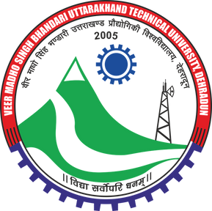
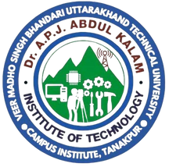


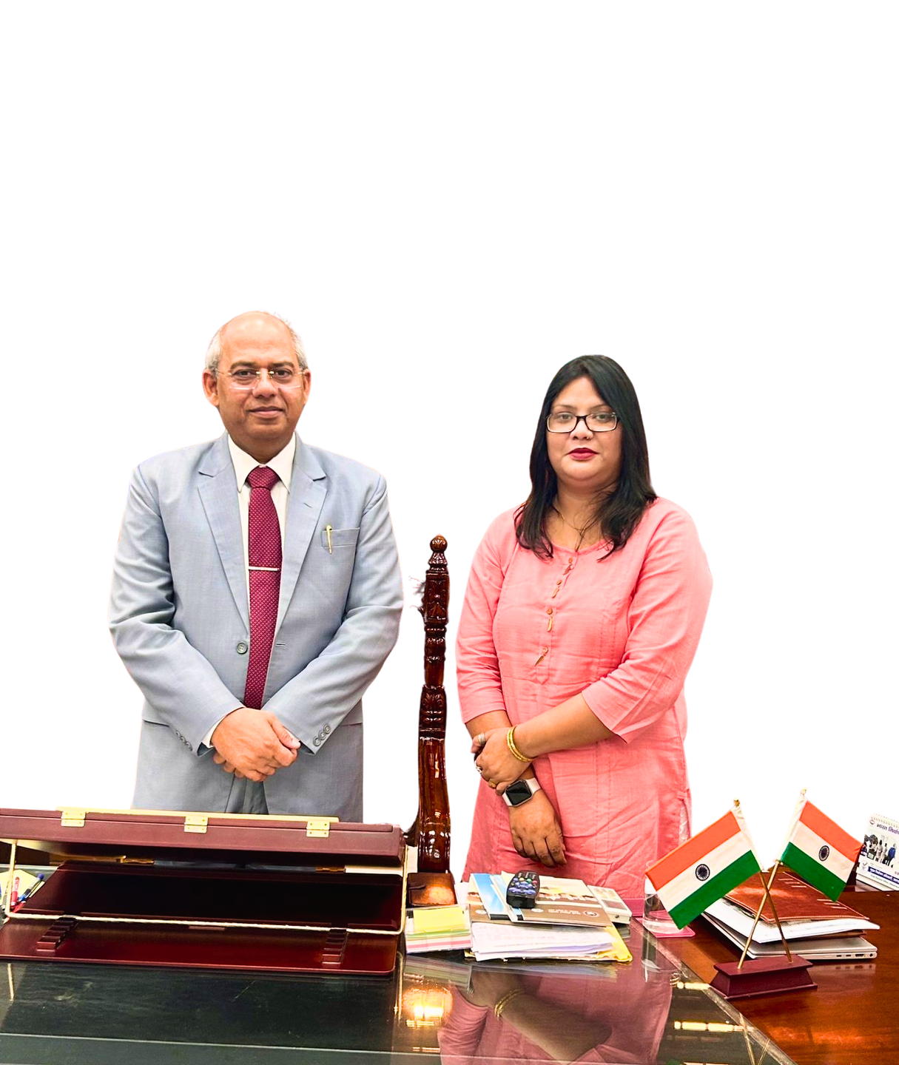
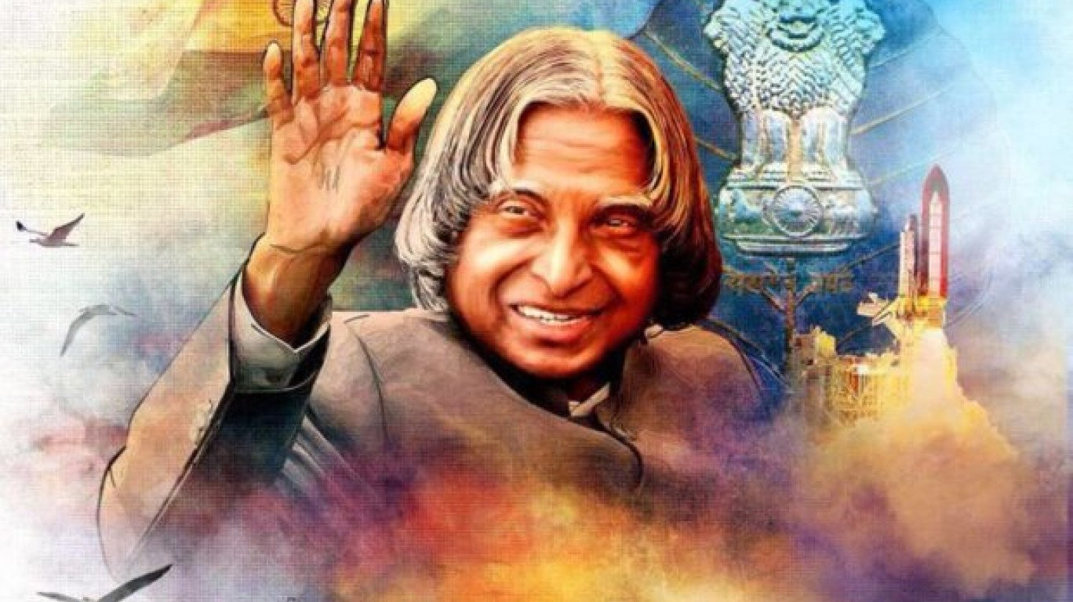
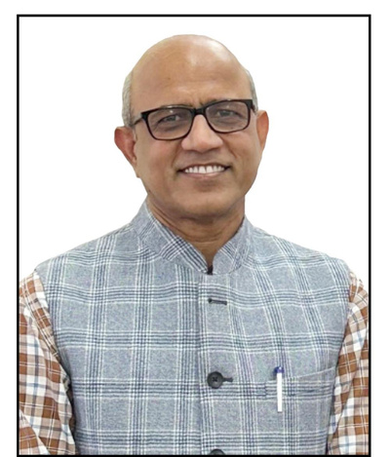

Welcome
All the Engineering Graduates
9th Foundation Day
Of
Dr. A.P.J. Abdul Kalam Institute of Technology, Tanakpur
(V. M. S. B. UTTARAKHAND TECHNICAL UNIVERSITY)
PROF. ONKAR SINGH
Prof. Hardwari Lal Mandoria
Vice Chancellor, V. M. S. B. UTU
Director, Dr. APJ AKIT, Tanakpur

Slide 2


Python Programming with IOT
Powered By- Softpro India Computer Technologies (P) Ltd.

Slide 3
SENIOR CONSULTANT
EXPERIENCE OF 11+ YEARS

Slide 4
I am having an Experience of more than 11+ Years working in Software Development field and have a great command in Programming Concepts & Database Administration.
Worked on multiple projects for prestigious clients of national repute like:
URISE – PMU Head (A Prestigious Project of Board of Technical Education Gov. of Uttar Pradesh)
Lalit Narayan Mithila University, Darbhanga, Bihar – College Automation System.
Green Gas Limited (GGL) – A Joint Collaboration of GAIL & IOCL
Medicounsel – USA
Karam Industries (P N International) – Safety Equipment Manufacturers
Sanjay Gandhi Post Graduate Institute, Lucknow

Slide 5
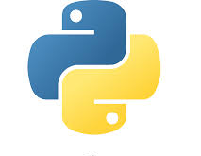
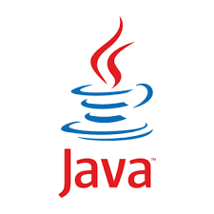

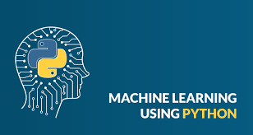

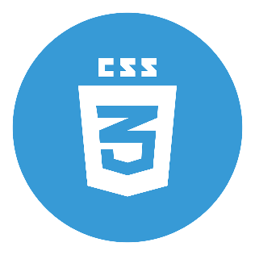
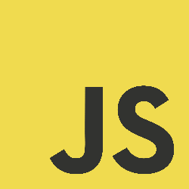

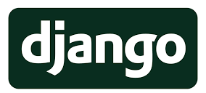
EXPERTISE SKILLS

Slide 6
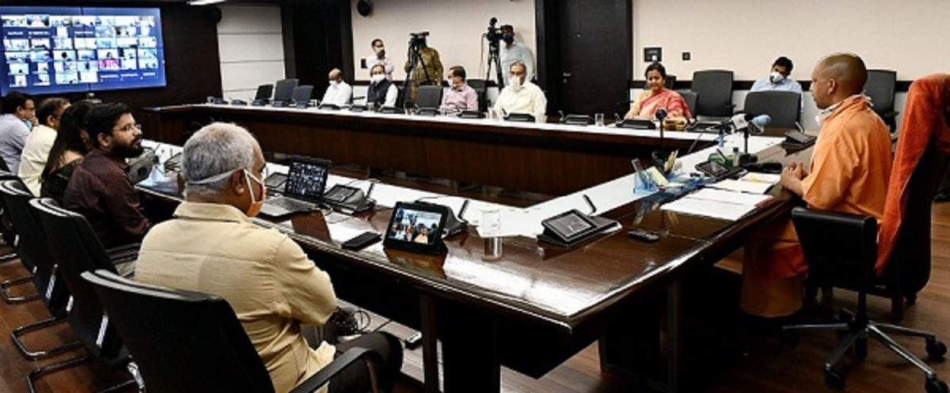
Glimpse of Inauguration of URISE Project in CMO, Lucknow by
Hon’ble Chief Minister Shree Yogi Adityanath

Slide 7
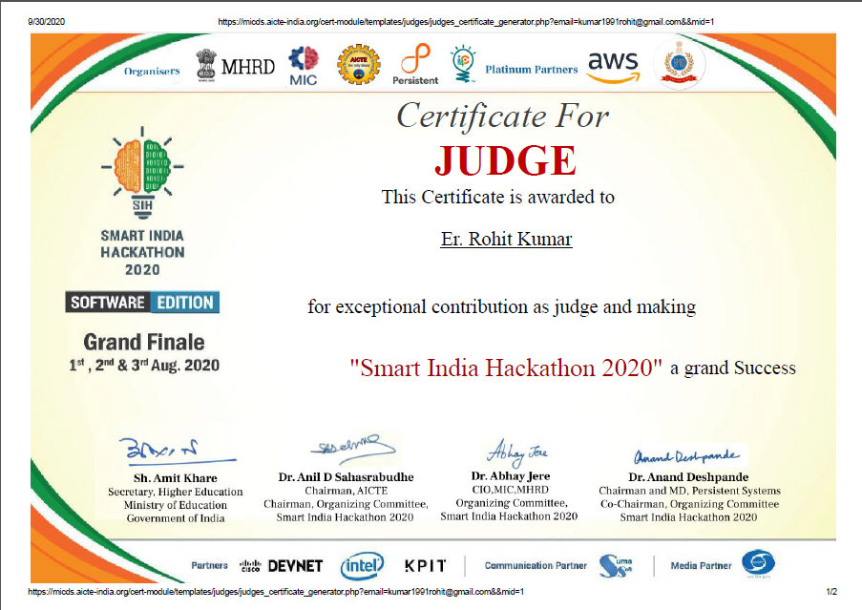
Recent Achievement's

Slide 8
ACHIEVEMENTS
AS A
TECHNOCRAT

Slide 9
1000
TECHNOLOGY
WORKSHOPS
CONDUCTED TILL DATE

Slide 10
Trained more than 01 Lac
Diploma and
Engineering
Graduates

Slide 11
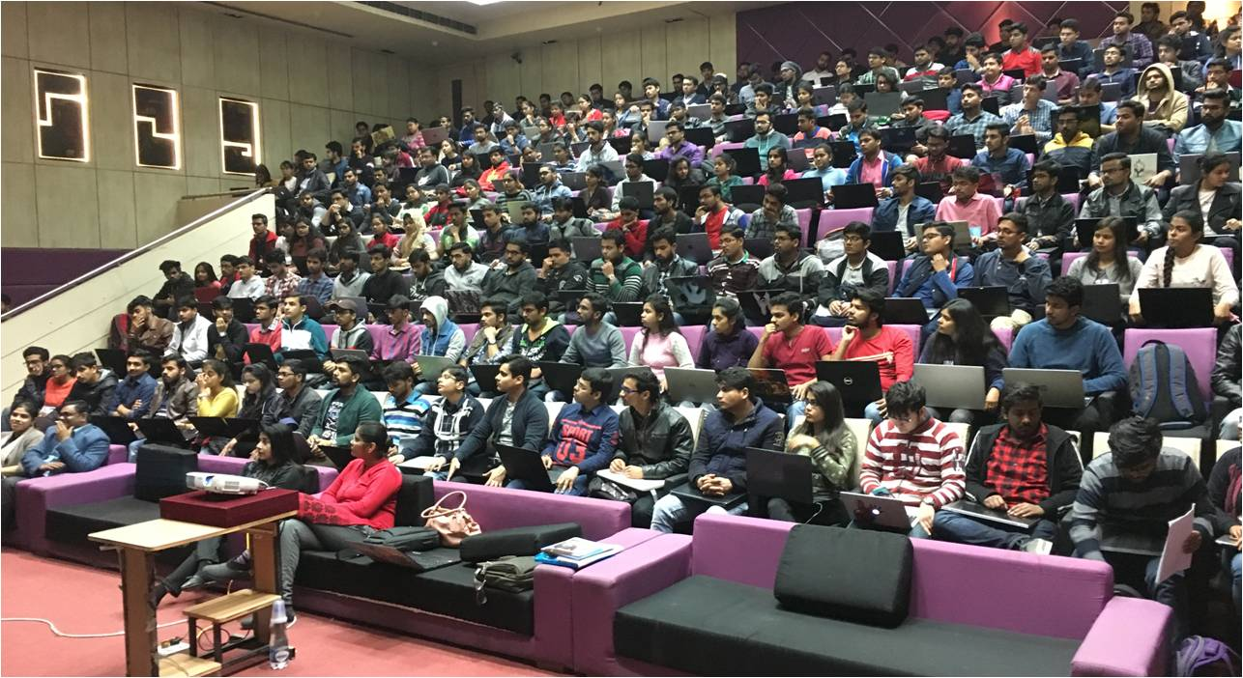
Industry Academia Interaction Program
Workshop at GALGOTIAS

Slide 12
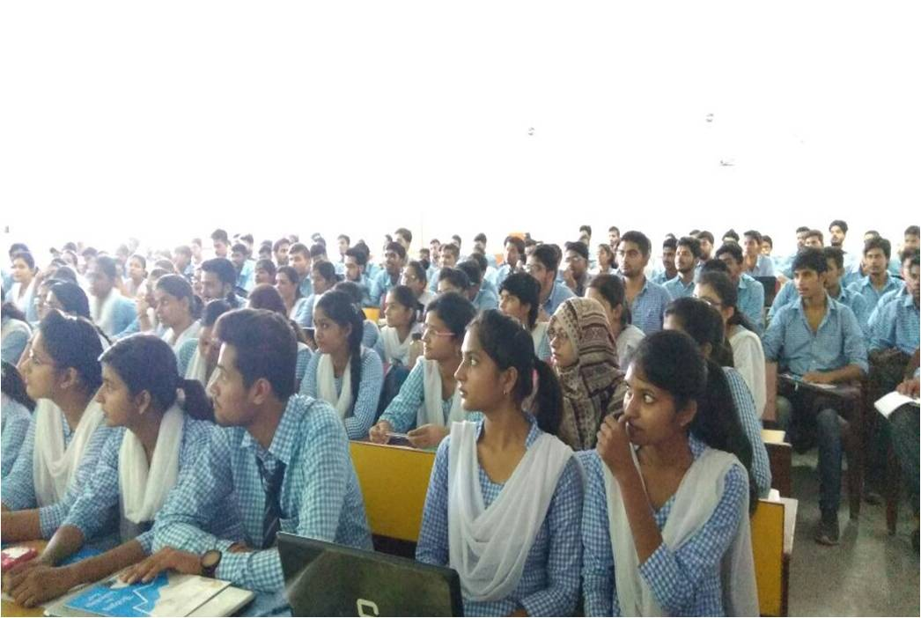
Industry Academia Interaction Program
Workshop at BBD Group, Lucknow

Slide 13
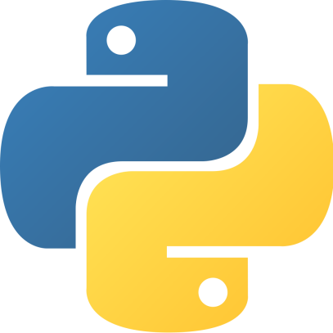
Today’s Agenda
Why Python is become very Popular Programming.
Is Python is the need of today’s generation.
What is Python?
Applications of Python.
Features of Python.
Comparison of Languages
Companies using Python.

Slide 14
WHY
PYTHON ??

Slide 15
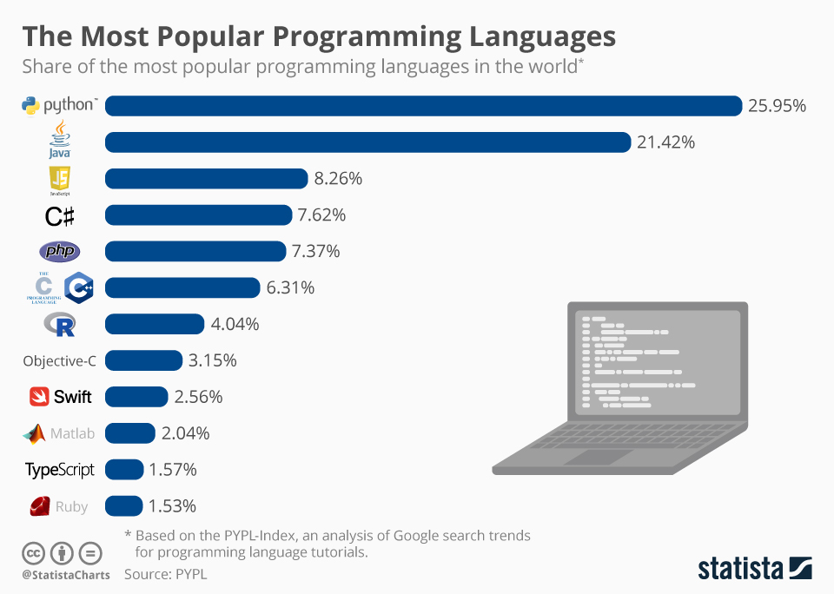

Slide 16
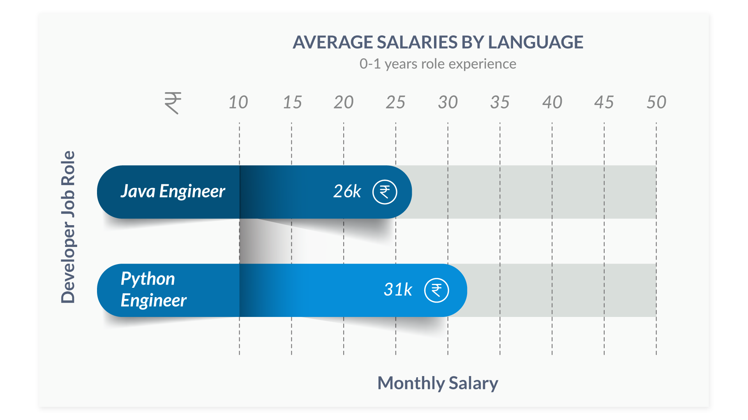

Slide 17
WHAT
IS
PYTHON ??

Slide 18
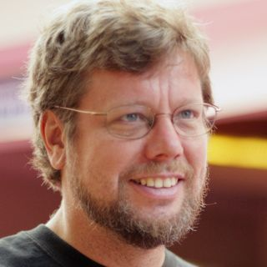
What is Python Programming ??
THE OFFICIAL DEFINITION
GUIDO VAN ROSSUM
Python is an Interpreted,
Object Oriented,
High Level Programming
language with Dynamic
Semantics.

Slide 19
Application areas of Python Programming
Web Development
Machine Learning & Artificial Intelligence
Data Science & Data Visualization
Desktop GUI
Game Development
Business Applications
Embedded Applications
IOT (Internet Of Things)

Slide 20
Features of Python Programming
Less line of codes than other languages.
Platform independent
It supports functional and structured programming methods
It provides very high-level dynamic data types and supports dynamic type checking
It supports automatic garbage collection.
Open Source
Object Oriented

Slide 21
COMPARISON OF
LANGUAGES

Slide 22
Simple Calculator Code Written In Java
import java.util.*;
class SimpleCalc
{
public static void main(String [] args)
{
Scanner sc=new Scanner(System.in);
System.out.println(“Enter two numbers”);
int a,b;
a=sc.nextInt();
b=sc.nextInt();
System.out.println(“Summation = ”+(a+b));
System.out.println(“Subtraction = ”+(a-b));
System.out.println(“Multiplication = ”+(a*b));
System.out.println(“Division = ”+(a/b));
}
}
Total line of codes = 17

Slide 23

Simple Calculator Code Written In C#
using System;
class SimpleCalc
{
public static void Main(String [] args)
{
Console.WriteLine(“Enter two numbers”);
int a,b;
a=int.Parse(Console.ReadLine());
b=int.Parse(Console.ReadLine());
Console.WriteLine(“Summation = ”+(a+b));
Console.WriteLine(“Subtraction = ”+(a-b));
Console.WriteLine(“Multiplication = ”+(a*b));
Console.WriteLine(“Division = ”+(a/b));
}
}
Total line of codes = 15

Slide 24
Simple Calculator Code Written In Python
a=int(input(“Enter first number : ”))
b=int(input(“Enter second number : ”))
print( “Summation =”,(a+b))
print (“Subtraction=”,(a-b))
print (“Multiplication =”,(a*b))
print (“Division =”,(a/b))
Total line of codes = 6

Slide 25

















COMPANIES USING PYTHON

Slide 26
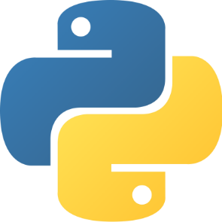
LET’S START OUR
JOURNEY WITH
PYTHON !!!

